Slide 1
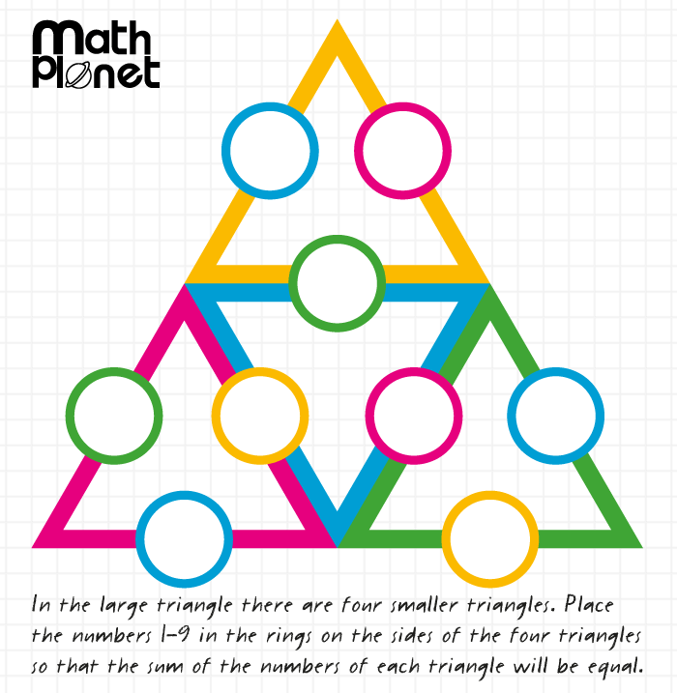
Topic: PRobability EQ: What is independence?
Solve(on LHS)
Steps to be successful this lesson:
Get materials out (notebook, pen, pencil, ruler, scientific calculator)
Rule up notebook and write Topic and EQ
Start on review questions →
Check your answers with someone sitting next to you
Is your notebook up to date? (Contents page, glossary, summary, review notes etc.)

Slide 2
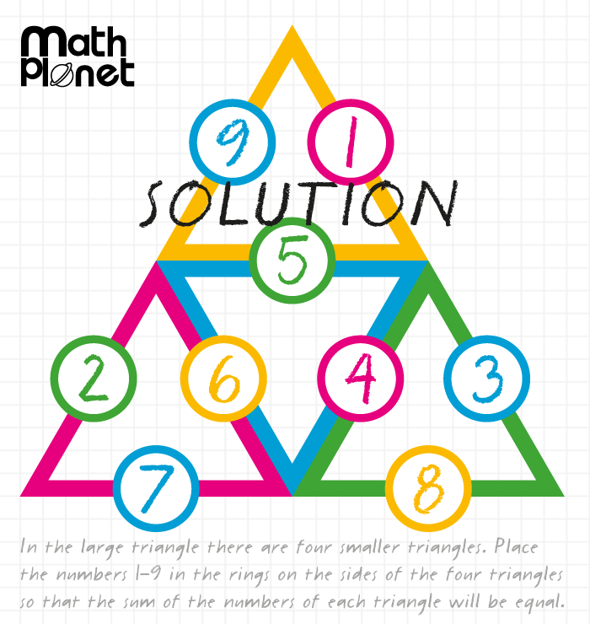
Topic: PRobability EQ: What is independence?
Answer
Steps to be successful this lesson:
Get materials out (notebook, pen, pencil, ruler, scientific calculator)
Rule up notebook and write Topic and EQ
Start on review questions →
Check your answers with someone sitting next to you
Is your notebook up to date? (Contents page, glossary, summary, review notes etc.)

Slide 3
Probability What is independence?
Year 10 Mathematics

Slide 4

24
7
30
Topic: Probability
Date: /06/2018
EQ – What is independence?
Events in probability can be categorised as independent or dependent.
Two events are independent if the probability of one event doesn’t depend on the outcome of another event.
Two events are dependent if the probability of one event depends on the outcome of another event.
What is an independent event?
What is a dependent event?

Slide 5
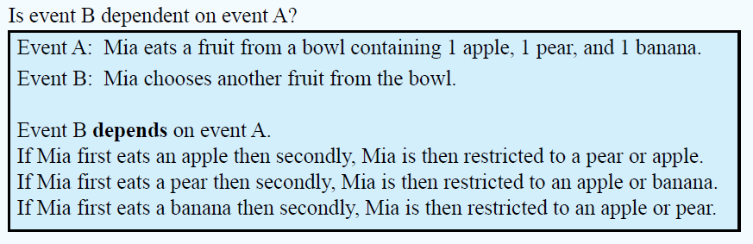
24
7
30
Topic: Probability
Date: /06/2018
EQ – What is independence?
Example
Why?

Slide 6
24
7
30
Topic: Probability
Date: /06/2018
EQ – What is independence?
Example

Slide 7


Slide 8
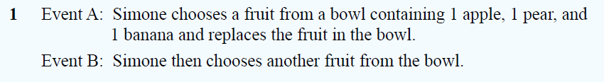
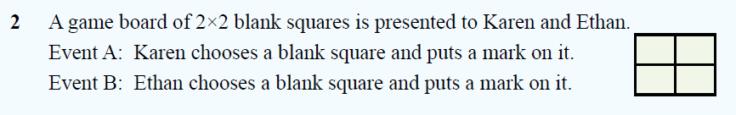
Task, Dwyer 10, Exercise 8.3
Determine the independence of these events

Slide 9
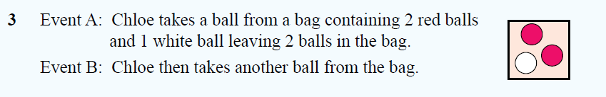

Task, Dwyer 10, Exercise 8.3
Determine the independence of these events

Slide 10
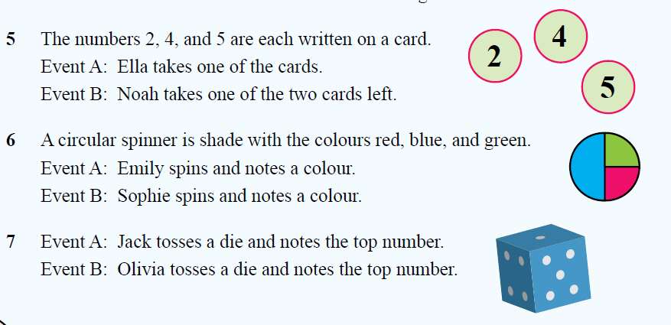
Task, Dwyer 10, Exercise 8.3
Determine the independence of these events

Slide 11
Task
Excel Worksheet
Independent Events
Dependent Events
Notes:
Dark hair, not dark hair
Short hair, long hair
Alternatives: boy / girl, shorts/pants

